Slide 1
Agricultural Survey Excellence Exploring ODK's Ecosystem
Khaled Al-Shamaa
Research Database Manager and Senior Analyst

Slide 2
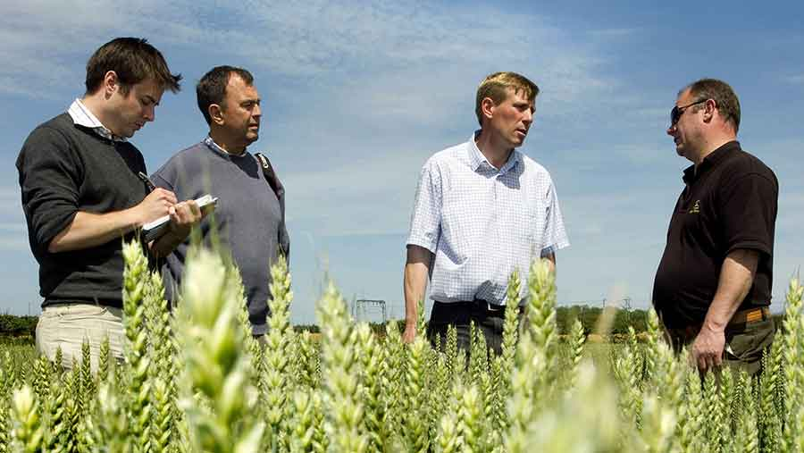
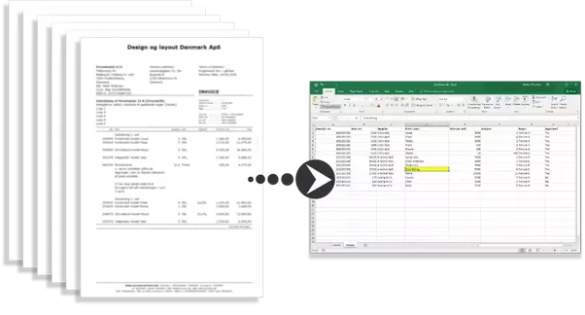
Traditional Survey Process

Slide 3
What is ODK?
Open Data Kit (ODK) is an open-source mobile data collection platform. It enables users to fill out forms offline and send form data to a server when a connection is found. Once on the server, the data can be viewed, downloaded, and acted upon.
Collect the data you need to make the right decisions (e.g., text, numeric, date, time, GPS location, media, barcode, choose one, select multiple, metadata). ODK tools also support grouping, skip logic, answer validation, repeat elements, calculations, multiple languages, and offline work!

Slide 4
Why ODK?
Build powerful forms
Collect data offline
Analyze with ease
Include photos, GPS locations,
Use either the mobile app or
Download your data or connect
skip logic, calculations, external
the web app. Forms and
apps like Excel, Power BI, or R to
datasets, multiple languages,
submissions are synced when a
create live
-
updating
and more.
connection is found.
dashboards.
Trusted across sectors
Proven at global scale
Open source
ODK is the standard in public
ODK is used globally by
ODK is open
-
source software.
health, global development,
organizations like yours to
Use as is, customize as you see
crisis response, climate
collect millions of submissions
fit, or try compatible
monitoring, and more.
every month.
alternatives.

Slide 5
Who are using ODK?
Millions of people use ODK to collect data because it works anywhere. Here are a few examples:
Food and Agriculture Organization (FAO)
World Health Organization (WHO)
World Food Program (WFP)
World Bank
Red Cross

Slide 6
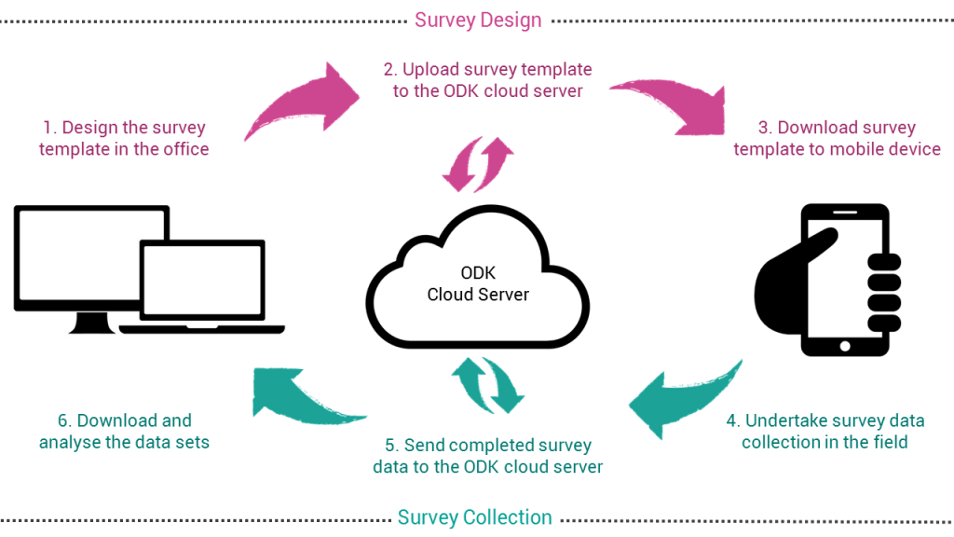
ODK Framework

Slide 7
ODK Eco-System
Design Survey Template:
ODK Build web-based tool for creating ODK forms used drag-and-drop interface.
XLSForm format (Excel template), then convert it into XForm using online tool.
Hosting Server:
ODK Central Server (needs hosting and IT support).
Service Providers (e.g., ODK Cloud, Ona, KoboToolbox, etc.).
Data Collection Client:
ODK Collect Android Application.
Extract Submitted Data:
Aggregate Export Functionality CSV/KML.
ODK Briefcase Utility.
OData and a RESTful API.

Slide 8
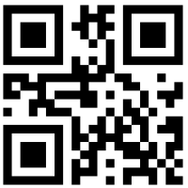
Design
Distribution
Collection
Reporting
Coordination
Decision Making
Conventional System
Send the Survey by Email in PDF Format and Print it on Paper
Time & Efforts Consuming in Spreadsheet Data Entry
Manually Aggregate Workers Data in One Master File
Domain Experts Design a Survey
Fill-in Paper Form
Freehand Writing
ODK System
Data from Field to DB: 3 steps vs. 1
Less Time & Errors + Geotagging
Feedback
Fill-in Electronic Form
Validation/Quality Control
No Internet Access Needed
GPS Geotagging
One Click to Send All Collected Data
No Time Barrier
No Extra Efforts
Briefcase & Aggregate
ODK Server Interface:
Progress Report and
Dataset Snapshot
ODK Experts Convert Survey into ODK Template
Host the Survey ODK Central Server
Analyzing
Capacity Building
Tuning
Development
2nd
1st
3rd
Designing Custom ODK Survey for Project Specific Needs
Field Demos of Geotagging the Interventions
Setup, Configure, and Administrate ODK Central Server at NARS Data Center
Auto Aggregate Submitted Field Data to Central ODK Repository
Realtime Dashboard
Connect to ODK via API
Maps, Live Indices/KPIs, and Summary Statistics

Slide 9
Case Study
Baseline study case: Digitized survey of 43 pages (~800 questions / data points).
Advantage: No delay or overhead process to get collected data on real-time.
Process:
Deliver training for +130 extension agents on using ODK Collect.
~3400 forms submitted from 173 villages in 4 provinces.
Setup ODK Aggregate server at national data center.

Slide 10
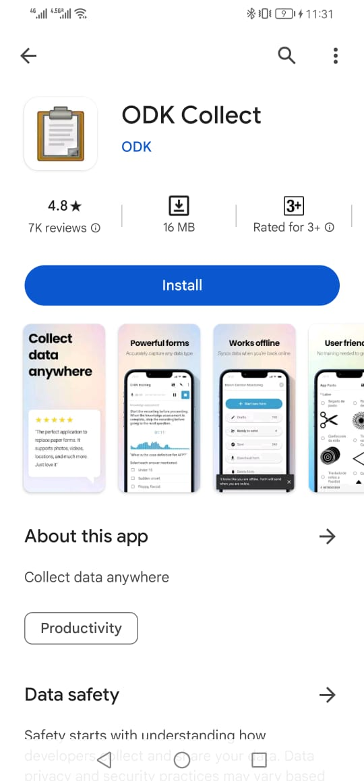
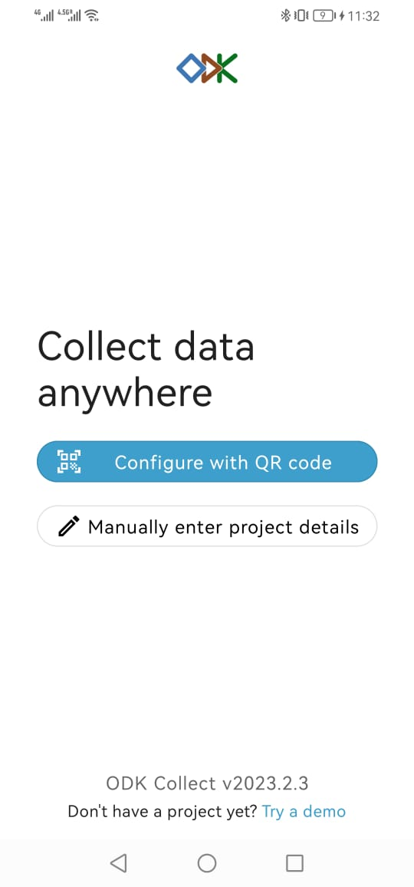
Install ODK Collect
Replace this by the QR code of your example survey

Slide 11
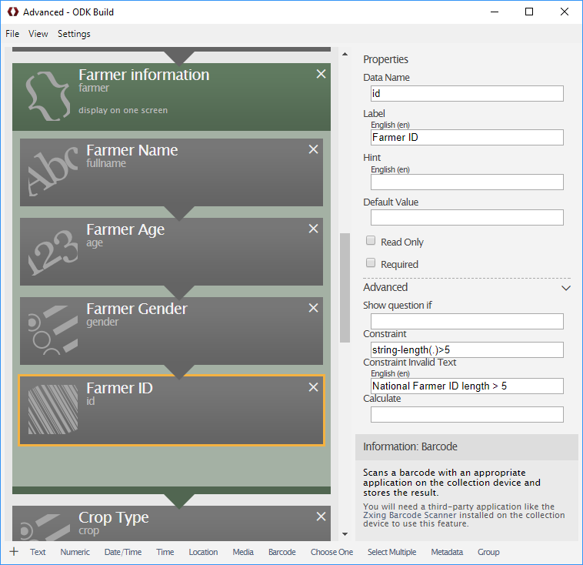
ODK Build
ODK Build is a web-based, drag-and-drop service for creating forms used with data collection tools such as ODK Collect. Build is available as an online and offline tool. The online version works with modern web browser and the offline version works on Windows, macOS, and Linux.
Online: Use https://build.opendatakit.org *
Offline: Download latest release on GitHub

Slide 12
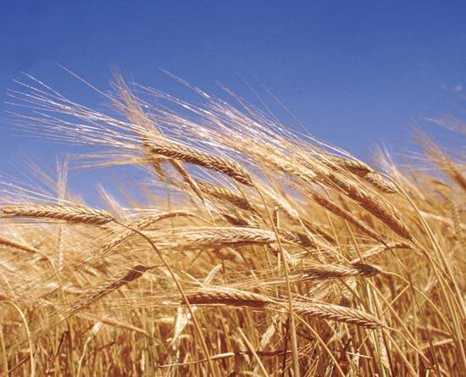
Questions?
Japanese attitude for work:
If one can do it, I can do it. If no one can do it, I must do it.
Middle Eastern attitude for work:
Wallahi... if one can do it, let him do it. If no one can do it, ya-habibi how can I do it?

